Slide 1
Forecasting RuneScapes Market using LSTM RNNs
Matthew Manoly, Steven Proctor, Harrison Ratcliffe, Zachary Taylor

Slide 2
Forecasting Financial Markets
Forecasting financial markets using neural networks started in the 1990s
Many different neural networks have been used, such as Multi-layers perceptrons, Recurrent LSTMs, and Convolutional neural networks
Forecasting financial markets is mainly used for predicting how stock markets will behave
Notes:
Background on forecasting markets

Slide 3
Why RuneScape?
Runescape has a system similar to the New York Stock Exchange
Simplicity of and familiarity with the system leads to a stronger foundation for the neural net to operate on.
When doing empirical testing, we can use in-game currency, not real money.
Market has a very diverse set of stocks (items) to track and try to profit off of.
Notes:
Background on Runescape/Why we chose to predict Runescape markets

Slide 4
Previous Work
LSTM RNNs have been used for forecasting financial markets
A group using an LSTM to predict the Chinese Stock Market approached 27.2% accuracy across all stock
CNN’s have been recently introduced and slightly outperform LSTM RNNs
A study in 2018 added a convolutional layer to a LSTM RNN, achieving higher prediction accuracy than previous CNN or LSTM RNN models

Slide 5
Gathering the Data
The dataset was gathered over a month-long period
Information for each item was retrieved every day by a web scraper built in Python
Used information on price trends for the current day and 30 days prior to construct the dataset
During the data gathering process, some items were ignored
Notes:
How we gathered the data
Data was scraped every day over a month long period
The web scraper, built in python, retrieved the information from Jagex Incs online item service database
Included a current, today, 30-day, and 90-day trend. We used the today and 30-day to construct our dataset
Some items had to be excluded as they crashed the web scraper

Slide 6
Neural Network Architecture
Data represented as percent changes in a 3D array (sequence, item, day)
We used a Recurrent Neural Network, trying both one and two LSTM layers.
Sequence size of four days, Adam optimizer, twenty days of data.
Double LSTM layer produced highest accuracy.
More layers may increase accuracy at a large cost to time.
Notes:
How we constructed our neural net
Single LSTM layer for time-series data with memory.
These params gave us the highest accuracy
More layers could be good if we had time to run them
Accuracy growth drops with more layers

Slide 7
Results
With a batch size of 1, sequence length of 4, and single LSTM layer, we got 19% peak accuracy with an overall average of 11%
Increasing batch size (2 and 4 were tested) improved runtime, but decreased accuracy
Changing the learning rate in any way decreased accuracy
Adding dropout also decreased accuracy
The 30 days ago data was dropped for causing issues.
Notes:
Results and possible reason why

Slide 8
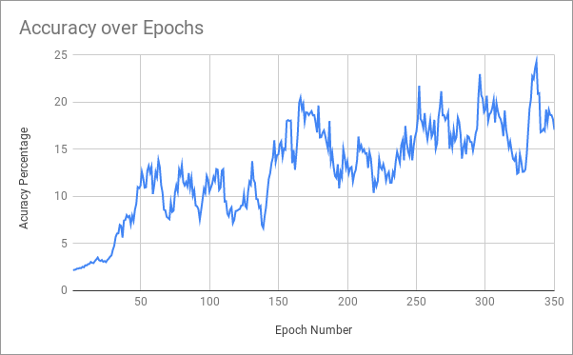
Results cont.
With a batch size of 1, sequence length of 4, and double LSTM layers, we got 24.3% peak accuracy, an overall average of 13%, and an average of 18% over the final 50 epochs.

Slide 9
What can be improved?
With more time, additional layers and data can be added to hone in on a higher accuracy.
More data will allow for larger sequence lengths, which can also improve accuracy.
Adding different types of layers, such as a CNN, may also help.
Notes:
Adding more layers, parameters
Gathering a larger dataset, or cleaning up the current one

Slide 10
Future Work
Attempt to improve accuracy
Try using different neural networks
Return the predictions for items and test them in Runescape
Test the network on other video games

Slide 11
QUESTIONS?

